Slide 1
VISA-demo implementation with Openstack at ESS Preliminary findings (very much work in progress)
19th October, 2021
Author: Brian L. Jensen, HPC System Officer (ESS, DMSC)

Slide 2
Agenda
1. Status & Overview
2. Next steps
3. VISA-demo implementation
4. Discussion on Openstack stuff (optional!)

Slide 3
VISA-demo implementation at ESS
Work in progress!
Current status:
VISA-demo installed and integrated successfully into a prototype Openstack implementation
VISA-example image built and imported to Openstack
Instances successfully deployed
Issues identified:
Deployment of instances (Openstack issue - resolved)
Experiment database (Database issue – resolved)

Slide 4
VISA-demo implementation – next steps
Finishing setup (i.e. fixing Openstack implementation to deploy VISA instances)
Play around with the deployed VISA-demo
Invite our instrument data scientists for a test-run and gather feedback
Implement full VISA into existing test infrastructure
Openstack, Keycloak etc.
Discuss implementation/API into Useroffice+Scicat with our UO dev team
Test/implement capability for Production
E.g. load balancing, failover, backup, scaling, live migration, external user experience
Develop local images (incl. applicable applications)

Slide 5
VISA implementation – thoughts (YMMV)
Full VISA installation
VISA components:
VISA Accounts
VISA WEB
VISA API
VISA Jupyter Proxy
….
VISA Interfaces:
Openstack
Keycloak
Reverse proxy
Load balancing
….

Slide 6
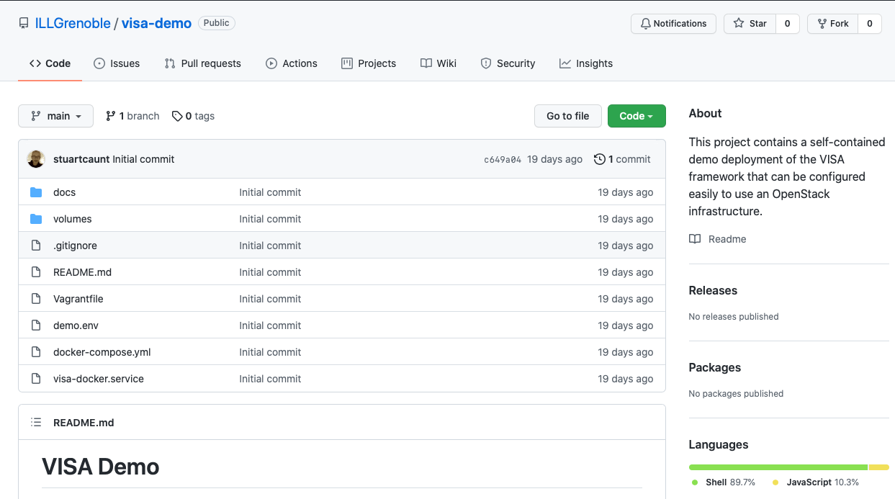
VISA implementation – thoughts (YMMV)
Go for VISA-demo first!
https://github.com/ILLGrenoble/visa-demo
Very nice and detailed instructions!
Easier with e.g. Ubuntu as host OS
Some customization needed for e.g. CentOS
VISA example image – really nifty!
Best to build on physical hardware!
VNC during build-process can be an advantage for the curious/impatient

Slide 7
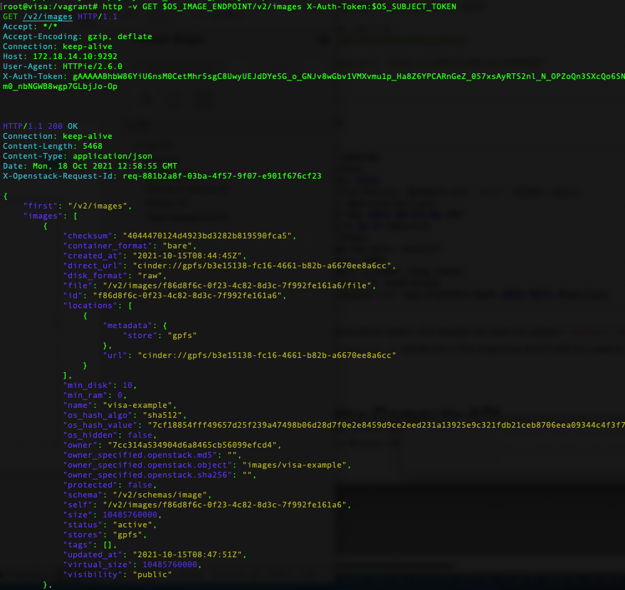
VISA implementation – thoughts (YMMV)
Openstack implementation
Be sure to setup the Application Credentials and Address Provider beforehand – really helps with debugging!

Slide 8
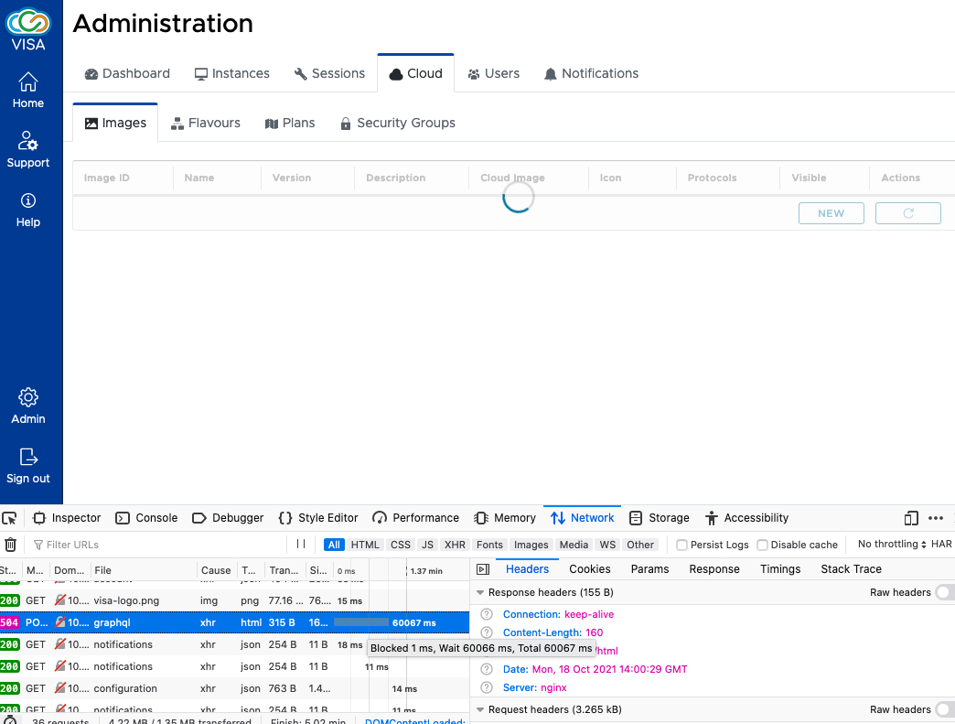
VISA implementation – thoughts (YMMV)
Openstack implementation
Use all tools and logs for troubleshooting– e.g. developer tools

Slide 9
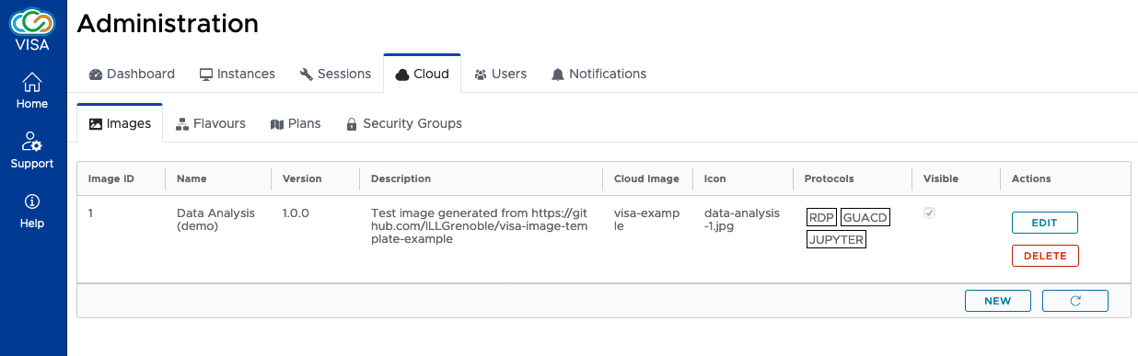
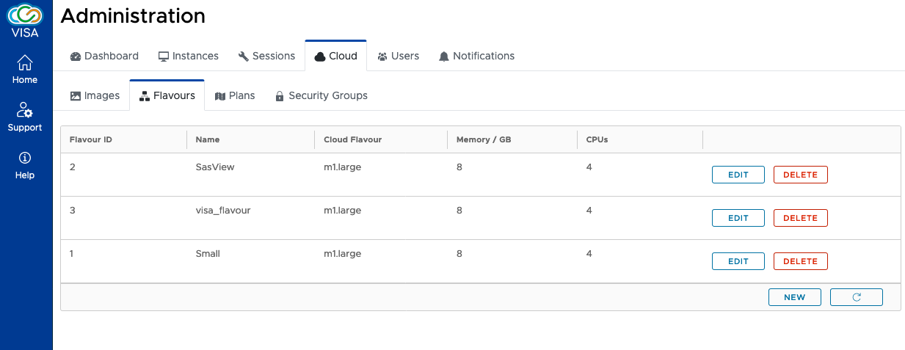
VISA implementation – thoughts (YMMV)
Openstack implementation

Slide 10
Openstack stuff…
Components
Keystone – service authentication
Nova - compute
Neutron – network
Cinder – block storage
Glance – image storage
Placement, Horizon, Swift
Deployment
Packstack
Ansible
Puppet
Network
Provider vs. self-service
ovs/ovn – dvr (distributed virtual routing)
Infiniband – SR-IOV vs. DPDK
Storage
Cinder – block-storage – many backends possible
Glance - volume-backed storage – e.g. copy-on-write
Troubleshooting
So…many…logs!

Slide 11
Thank you
email@email.eu

